Slide 1
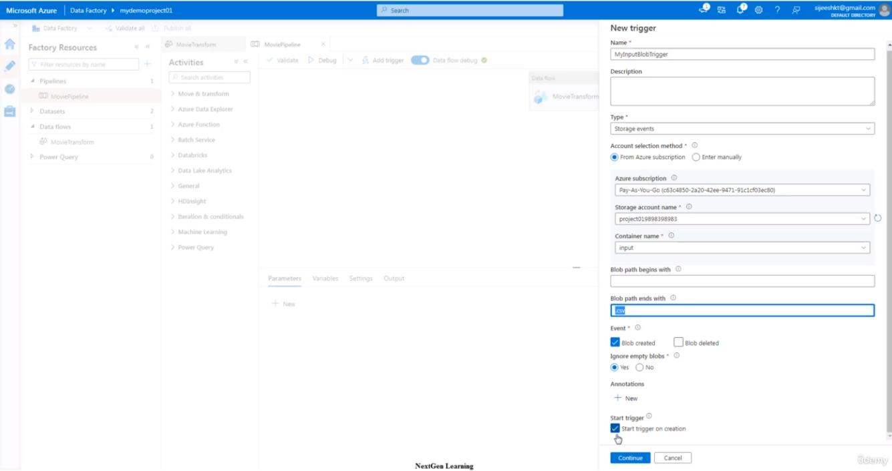
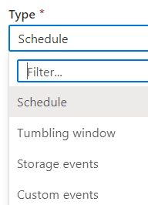
.csv
Whenever .csv uploaded in container(input), trigger starts and completes entire process.

